Slide 1
A Method for Storing Semiconductor Test Data to Simplify Data Analysis
Jeremy W. Webb
J. Webb Consulting
jeremy.webb@jwebb-consulting.com

Slide 2
Outline
Introduction
Data Producers and Consumers
Data Sources
Data Import
Database Structure
Data Analysis
Q&A

Slide 3
Introduction
Developing a parametric database for storing semiconductor test data:
Large volume of data
Extracting useful information
Analyzing data
Notes:
This paper describes the steps necessary to develop a parametric database for storing semiconductor test data.
A large volume of data is generated during semiconductor fabrication, wafer testing, and package testing.
Extracting any useful information from this collection of files can be challenging.
Custom scripts, Excel spreadsheets, R, GNU Plot scripts employed to make sense of data for performance and yield analysis.

Slide 4
Parametric Database Design
Interviews
Producers
Consumers
Sources
Design
Foundry
Import
XML
Load Scripts
Production
Database
Structure
Relationships
Analysis
Yield
Performance
Reports
Automation
Views

Slide 5
Data Producers
Who or What Produces Data?
IC Design and Test Engineers
Wafer Foundries
Test Executive Software
Common Questions
What type of data do you generate?
Where do you store data?
What type of specifications exist for devices?

Slide 6
Data Consumers
Who or What Consumes Data?
IC Design, Test, and Quality Engineers
Managers and Production Planners
Test Executive Software
Common Questions
What type of data do you access? Where do you access data?
Do you have to reformat data prior to analysis?

Slide 7
Data Sources Design Data
GDSII Documentation Layer
Describes reticle makeup, including row/column positions of each DUT.
Reticle row/column positions translated into wafer level X/Y coordinates.
ChipID for each DUT calculated using wafer level X/Y coordinates.
ChipID used to link measurement data with appropriate DUT.
Notes:
GDSII files are difficult to parse, tends to be an iterative process.

Slide 8
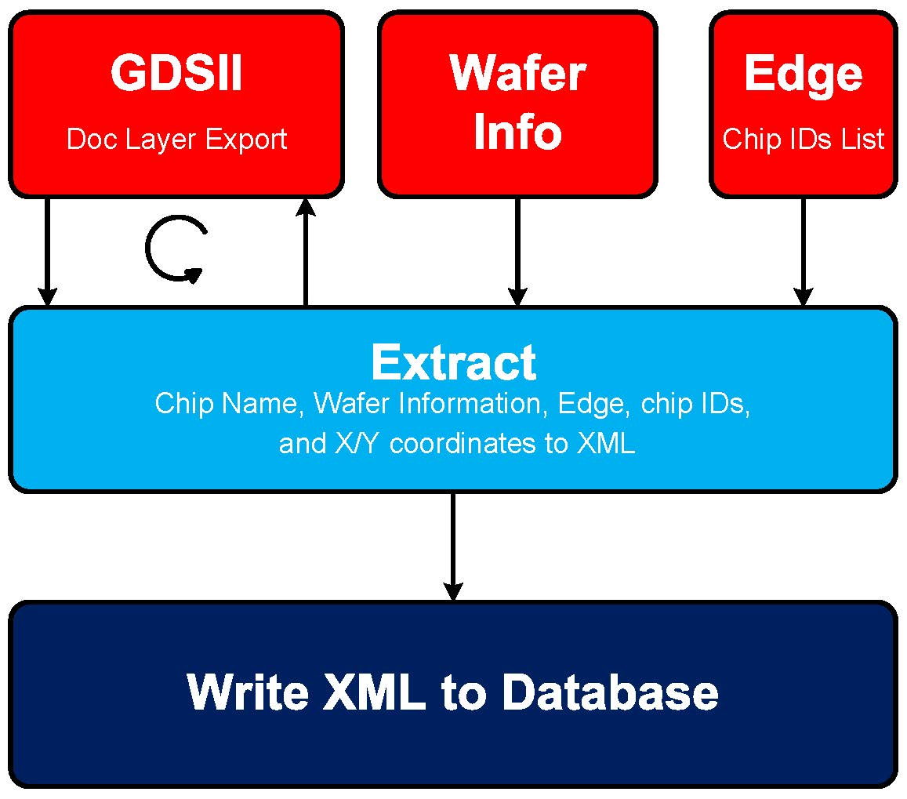
Data Sources Design Data – Process

Slide 9
Data Sources Design Data – XML File
<?xml version="1.0" encoding="UTF-8"?>
<mask>
<info>
</info>
<mask_params>
</mask_params>
<gdsii>
</gdsii>
<reticle>
</reticle>
<dut id="DEV-01">
</dut>
<die id="A5500">
</die>
</mask>
<mask_params>
<x_width>150000.0</x_width>
<y_height>150000.0</y_height>
<center_column>4.0</center_column>
<center_row>4.0</center_row>
<x_offset>0.0</x_offset>
<y_offset>7.0</y_offset>
<rim_scale>1.2</rim_scale>
<max_reticle_cols>9.0</max_reticle_cols>
<max_reticle_rows>8.0</max_reticle_rows>
<wafer_x_offset>-1000.0</wafer_x_offset>
<wafer_y_offset>0.0</wafer_y_offset>
<inner_ring>0.96</inner_ring>
<middle_ring>0.98</middle_ring>
<outer_ring>1.0</outer_ring>
<pcm_xoffset>0.0</pcm_xoffset>
</mask_params>
<gdsii>
<filename>mychip.gds</filename>
<filesize>51200</filesize>
<filepath>/prod/wafer/mychip/</filepath>
<fileblob><snip></fileblob>
<filedump><snip></filedump>
<timestamp>1404616217</timestamp>
<quadrant>Q</quadrant>
</gdsii>
<reticle>
<width>18400</width>
<height>21320</height>
<scale>0.00000100</scale>
<units>meters</units>
<makeup>whole</makeup>
</reticle>
<dut id="DEV-01">
<dut_key>DEV-01</dut_key>
<dut_family>DEV</dut_family>
<dut_type>01</dut_type>
<dut_x>920</dut_x>
<dut_y>1640</dut_y>
</dut>
<dut id="PCM-01">
<dut_key>PCM-01</dut_key>
<dut_family>PCM</dut_family>
<dut_type>01</dut_type>
<dut_x>920</dut_x>
<dut_y>1640</dut_y>
</dut>
<die id="A5500">
<die_key>DEV-01</die_key>
<die_family>DEV</die_family>
<die_type>01</die_type>
<die_quadrant>A</die_quadrant>
<die_x>73600</die_x>
<die_y>63960</die_y>
<die_edge>0</die_edge>
</die>
<die id="snip">
</die>
<die id="D5501">
<die_key>DEV-01</die_key>
<die_family>DEV</die_family>
<die_type>01</die_type>
<die_quadrant>D</die_quadrant>
<die_x>74520</die_x>
<die_y>63960</die_y>
<die_edge>0</die_edge>
</die>
<info>
<mask_name>aa001</mask_name>
<timestamp>1404616217</timestamp>
<material>gaas</material>
<device_type>wafer</device_type>
<makeup>whole</makeup>
<foundry>foundry1</foundry>
</info>

Slide 10
Data Sources Foundry Data
Data Types:
Open Purchase Orders
Work In Progress Status
Process Control Monitor Data
Wafer Level Test Data
Header Information
Wafer mask name
Wafer lot number or identifier
Wafer number
Test station identifier
Test date and time
Measurement conditions
Notes:
Open PO:
Indicates new masks or wafer lots in the pipeline
WIP:
Process of wafer fabrication and testing,
An interesting observation during the dB development was that the process steps vary from wafer to wafer.
PCM Data:
Performance of PCM circuits on wafer mapped to XY Coordinates
Wafer Test:
Functional Test results mapped to XY Coordinates
Work with foundry to ensure proper meta data is stored in header of test results and that the format stays consistent to avoid breaking parsing scripts.
Always include a file format version number!
Ask them to include specifications for each measured parameter.
If device test data is provided in separate files (aka, Swept Measurement Data), then the ChipID should also be included.

Slide 11
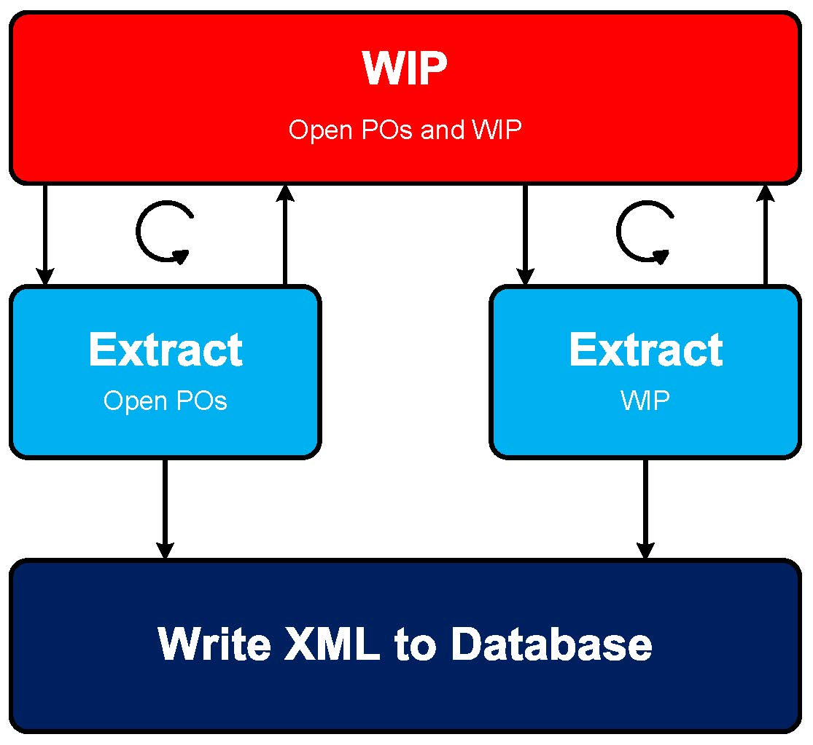
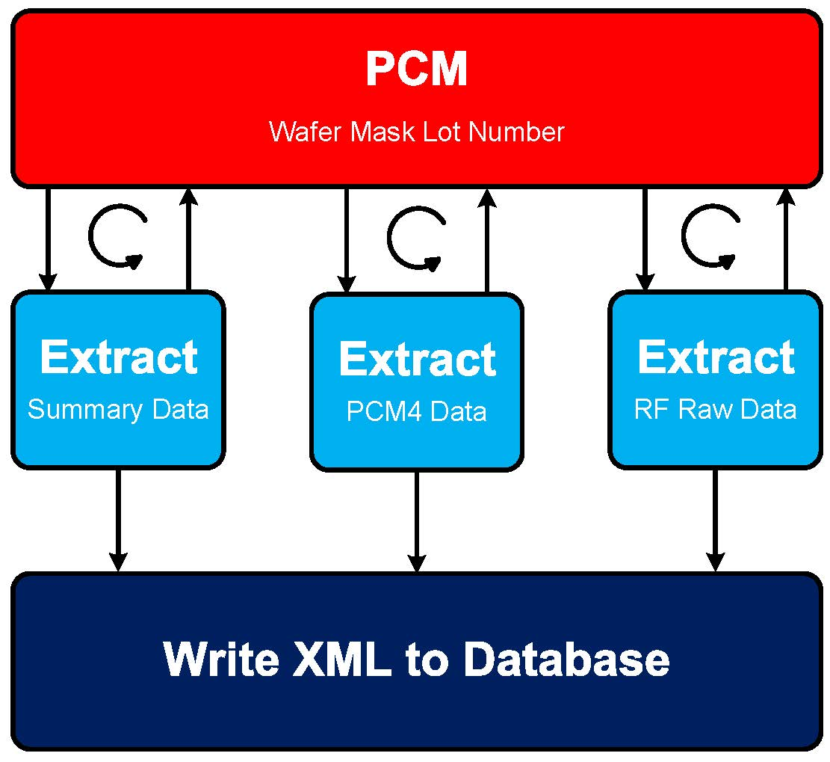
Data Sources Foundry Data – Process

Slide 12
Data Sources Production Data
Intermediate Data Storage
Combined File (e.g., CSV or Excel)
Separate Files
Database (i.e., session or production)
Data Types
Parametric Test Data
Swept Measurement Data
Notes:
Intermediate Data Storage
Combined Files
Problems exist when test runs start/stop. Never a cohesive file and manual merging is typically required.
Separate Files
Typical format is a custom flat file with structure (aka, sections containing info, specs, measurements)
Database
Session dB can be a SQLite dB file.
Production dB would be the MySQL/MariaDB dB hosted on a remote server.
Data Types
Parametric Test Data
Contain discrete measurement data.
Typically thousands of files or rows in spreadsheet or dB per wafer.
Swept Measurement Data
Network Analyzer Touchstone Files (*.s2p, *.s4p, *.sNp)
Typically thousands of files.
Number of frequency points per sweep can vary.

Slide 13
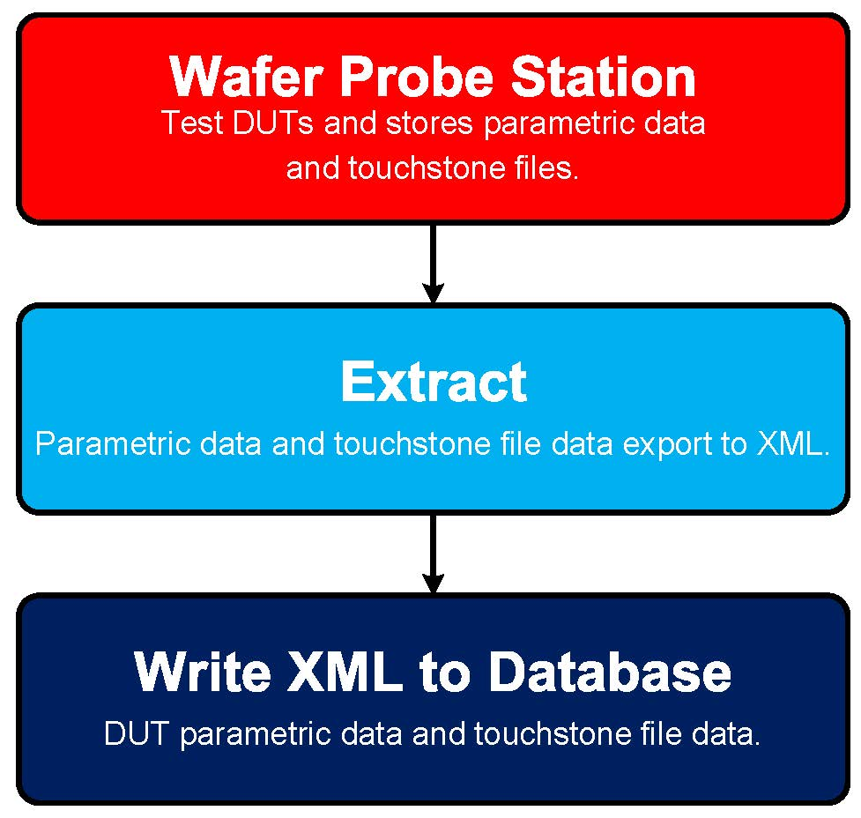
Data Sources Production Data – Process

Slide 14
Data Sources Production Data – Parametric Test Data
<?xml version="1.0" encoding="UTF-8"?>
<die_data>
<info>
</info>
<specifications>
<spec_class id="DEV-01">
<specification id="Ambient">
</specification>
</spec_class>
</specifications>
<measure>
<measure_class id="DEV-01">
<parameter id="Ambient Temperature">
</parameter>
</measure_class>
</measure>
</die_data>
<specifications>
<spec_class id="DEV-01">
<specification id="Ambient">
<spec_low_value>15</spec_low_value>
<spec_high_value>35</spec_high_value>
<spec_units>degC</spec_units>
<spec_desc>Ambient Temperature</spec_desc>
<spec_type>parameter</spec_type>
</specification>
<specification id="Idss">
<spec_low_value>0.22</spec_low_value>
<spec_high_value>0.33</spec_high_value>
<spec_units>Amps</spec_units>
<spec_desc>Drain Current</spec_desc>
<spec_type>parameter</spec_type>
</specification>
</spec_class>
</specifications>
<measure>
<measure_class id="DEV-01">
<parameter id="Ambient Temperature">
<param_value>21.264</param_value>
<param_units>degC</param_units>
<param_cond>Vg=0.0, Vd=8</param_cond>
<param_status>passed</param_status>
</parameter>
<parameter id="Idss">
<param_value>0.2869048</param_value>
<param_units>Amps</param_units>
<param_cond>Vg=0.0, Vd=8</param_cond>
<param_status>passed</param_status>
</parameter>
</measure_class>
</measure>
<info>
<file_version>1.1</file_version>
<username>jwwebb</username>
<timestamp>1404616217</timestamp>
<mask_name>aa001</mask_name>
<lot_number>1</lot_number>
<wafer_id>1</wafer_id>
<quadrant>q</quadrant>
<device_type>wafer</device_type>
<material>gaas</material>
<dut_family>DEV</dut_family>
<dut_type>01</dut_type>
<dut_chipid>A5500</dut_chipid>
<dut_status>PASSED</dut_status>
<test_sequence>first-pass</test_sequence>
<test_system>TS10</test_system>
<test_type>final_test</test_type>
</info>

Slide 15
Data Sources Production Data – Swept Measurement Data
<?xml version="1.0" encoding="UTF-8"?>
<touchstone>
<info>
</info>
<sparameters>
<data_row id="100000000">
</data_row>
<data_row id="snip">
</data_row>
</sparameters>
</touchstone>
<info>
<mask_name>aa001</mask_name>
<username>jwwebb</username>
<timestamp>1404616217</timestamp>
<material>gaas</material>
<quadrant>q</quadrant>
<lot_number>1</lot_number>
<wafer_id>1</wafer_id>
<device_type>wafer</device_type>
<dut_family>DEV</dut_family>
<dut_type>01</dut_type>
<dut_status>FAILED</dut_status>
<dut_chipid>A5500</dut_chipid>
<test_sequence>single-pass</test_sequence>
<test_system>TS10</test_system>
<test_type>final_test</test_type>
<option_line># HZ S RI R 50</option_line>
</info>
<sparameters>
<data_row id="100000000">
<freq>100000000</freq>
<s11_im>0.02047161</s11_im>
<s11_re>-0.04349013</s11_re>
<s12_im>-0.0001343436</s12_im>
<s12_re>1.809457e-05</s12_re>
<s21_im>1.051201</s21_im>
<s21_re>-3.672653</s21_re>
<s22_im>0.07070011</s22_im>
<s22_re>-0.1499106</s22_re>
</data_row>
<data_row id="snip">
</data_row>
</sparameters>

Slide 16
Data Import Production Data
XML Root Element Detection
Common XML Child Elements
info – describes the data in the XML file
specifications – describes the pass/fail criteria
measure – contains the measurement data
Batch Import Scripts
Bottom up approach for discrete test files
Staged Import
Manually performed tests
Data generated from legacy systems
Either nightly or “hot” staging
Notes:
XML Root Element Detection
Is it a mask, PCM data, test data, etc.
Common XML Child Elements
info – Describes the data within the XML file (aka, material, device type, ChipID
Batch Import Scripts
Bottoms up approach; develop import scripts for single file, then develop script to import all files in a specific directory, then develop script to import a list of directories
Staged Import: Web Based Staging Form
Manual tests generate no trigger that data is ready for upload into the database.
Augmenting legacy systems to directly import into a database may be difficult or impossible.
Data staged for nightly imports occur at regular time slots on a daily basis (i.e., cron job running nightly at 10pm)
Data staged for “hot” import should occur within a very narrow time range (i.e., cron job running every 30 minutes to an hour to determine if data is available for “hot” import).

Slide 17
Data Import Foundry Import
FTP sites
Foundry hosted
Locally hosted
Conventions
File name generation
Compressed file directory structure
Foundries can accommodate requests to store additional information in FTP sites or to transfer data in your local FTP site.
Notes:
FTP Sites are typically used to distribute PCM and functional test data
If not, then request that either an FTP site be created or create your own and have them push data to your site upon completion of any testing.
Agree on file naming conventions and compressed file structure (if used) to simplify parsing/import operations
Request access to open purchase orders, work in progress, PCM data, and wafer level test data via FTP.

Slide 18
Database Structure Table Creation
Initial tables created after user interviews.
Table relationships refined over time.
Table Types:
System Tables
Map Tables
Wafer Tables
Database IDEs, such as NaviCat®, are convenient for visualizing the table structure.

Slide 19
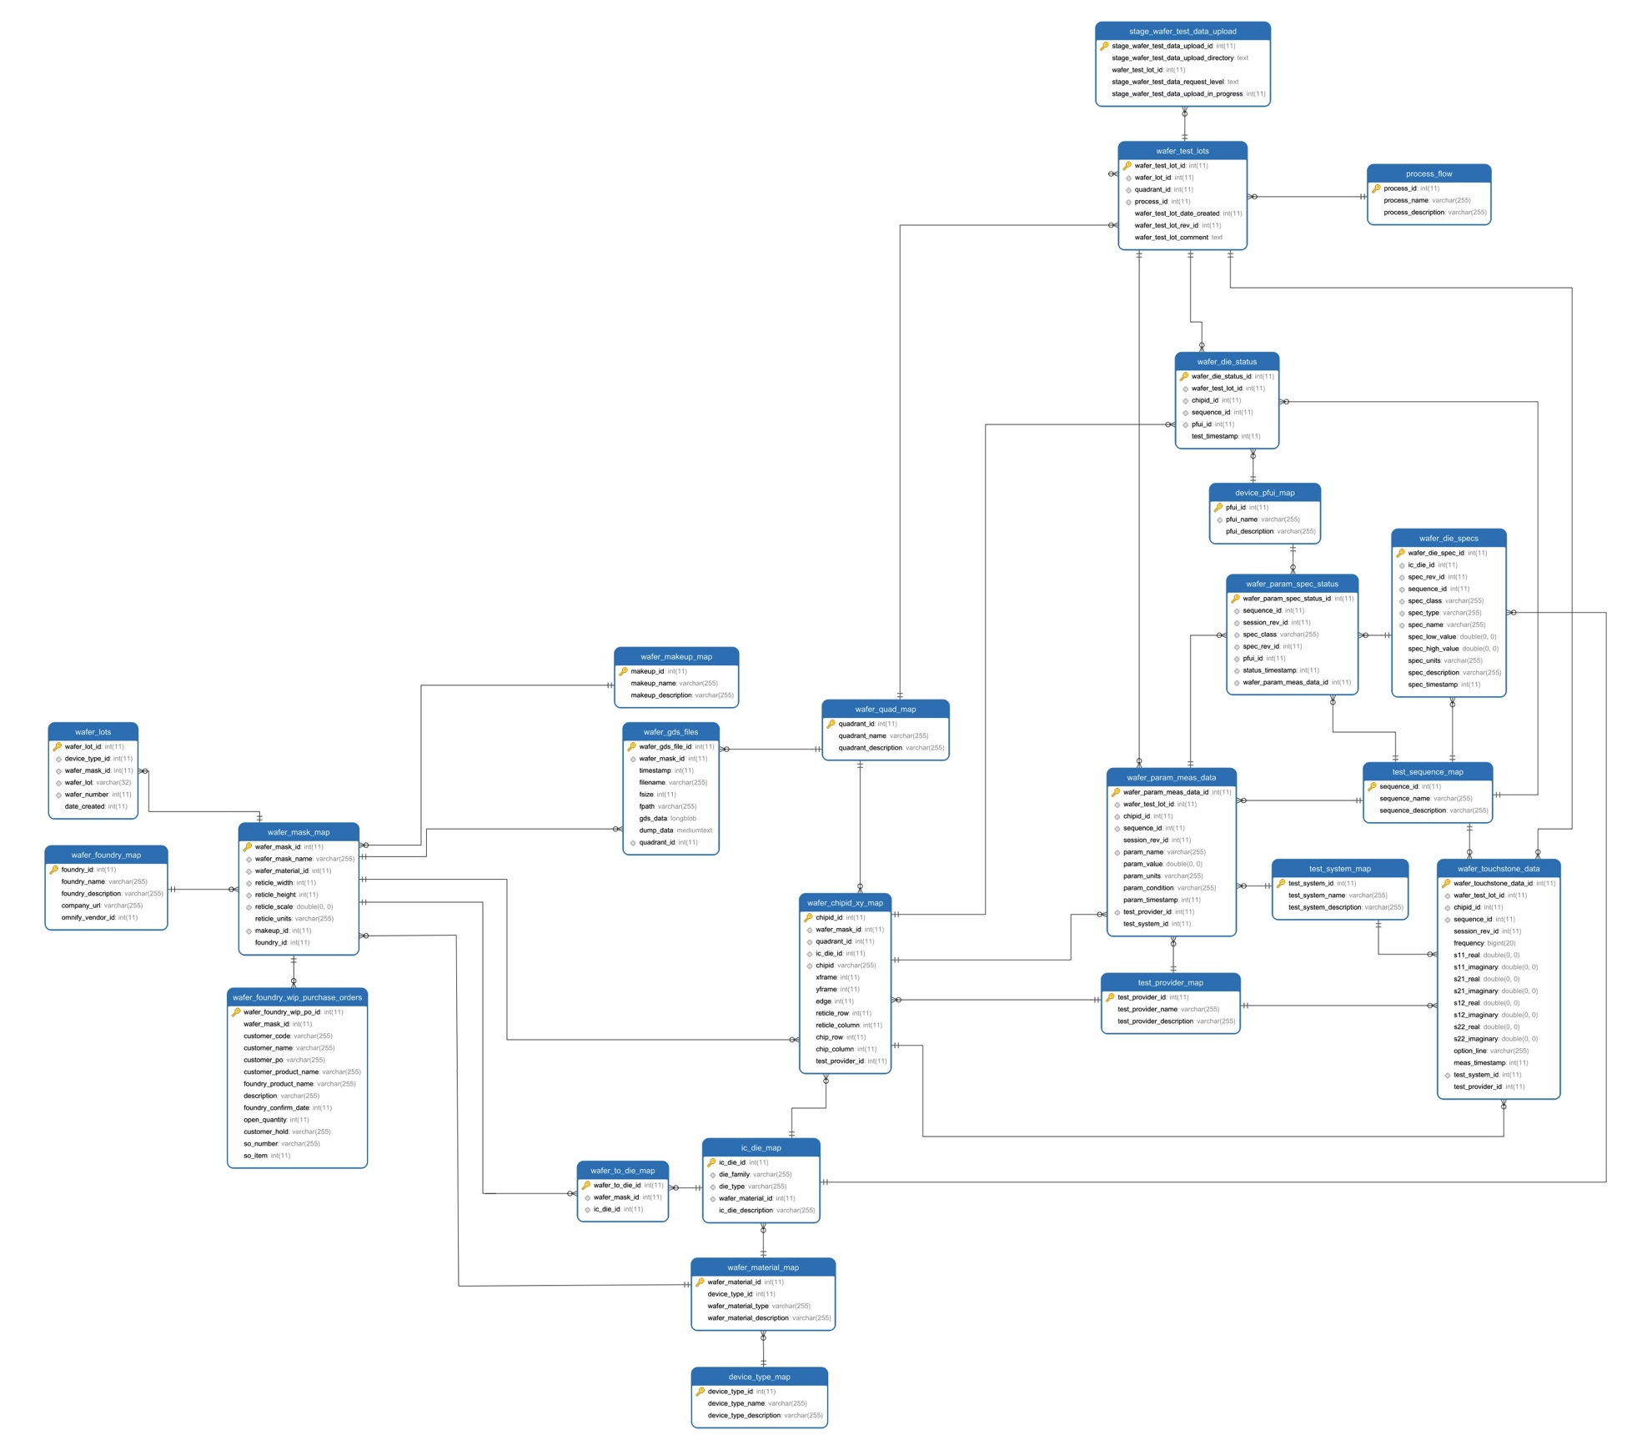
Database Structure Model

Slide 20
Data Analysis
Parametric database is accessed via ODBC.
Data analysis is performed by querying the tables and views.
Third party tools:
R
JMP® from SAS
Matlab® from Mathworks
Microsoft Excel®
Scripting Languages, such as: Perl and Python

Slide 21
Questions
Thank You!
Jeremy W. Webb
J. Webb Consulting
jeremy.webb@jwebb-consulting.com

